Slide 1

Predictive Analytics in Business (BUAN 448–Data Pre-Processing)
BUAN 488 – Fall 2022 – Dr. Davoodi

Slide 2
Agenda
Working with Datasets
The Process of Data Mining
Pre-processing Data
Overfitting & Partitioning

Slide 3
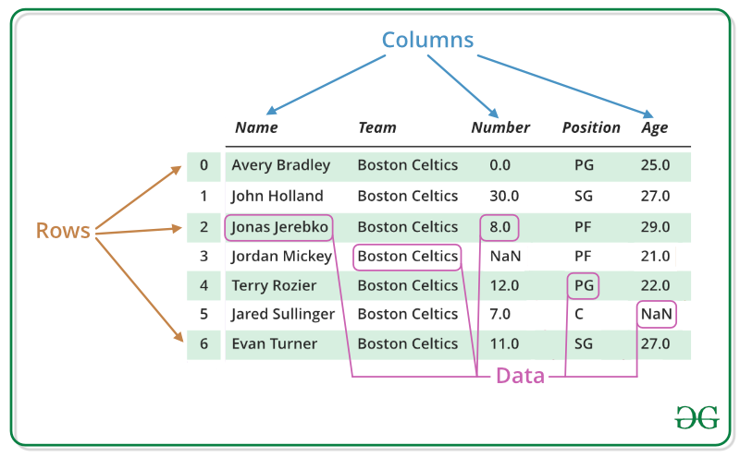
Organization of Datasets
Datasets are nearly always constructed and displayed so that
Variables are in columns
Records are in rows
https://www.geeksforgeeks.org/dataframe-operations-in-r/

Slide 4
Example: Predicting Home Values in the West Roxbury Neighborhood
Boston property assessment data on WestRoxbury.csv
Loading and Looking at the Data in R
Open “Ch2_0.R”
R Script.
Work with Table 2.3 Section

Slide 5
Sampling from a Database
Typically, we perform data mining on less than the complete database.
Algorithm Limitations
Accurate models can often be built with as few as several thousand records.
Open “Ch2_0.R”
R Script.
Work with Table 2.4 Section

Slide 6
The Process of Data Mining

Slide 7
Steps in Data Mining
Define/understand the purpose
Obtain data (may involve random sampling)
Explore, clean, and pre-process data
Reduce the data dimension
Specify task (classification, clustering, etc.)
Choose the techniques (regression, neural networks, etc.)
Use algorithms
Assess/interpret results – compare models
Deploy the best model

Slide 8
Pre-processing Data

Slide 9
Types of Variables
Determine the types of pre-processing needed, and algorithms used
Main distinction: Categorical vs. Numeric
Numeric
Continuous
Integer
Categorical
Ordered (low, medium, high)
Unordered (male, female)

Slide 10
Variable handling
Numeric
May occasionally need to “bin” into categories
Categorical
In most other algorithms, must create binary dummies (number of dummies = number of categories – 1)
Open “Ch2_0.R”
R Script.
Work with Table 2.5 & 2.6 Section

Slide 11
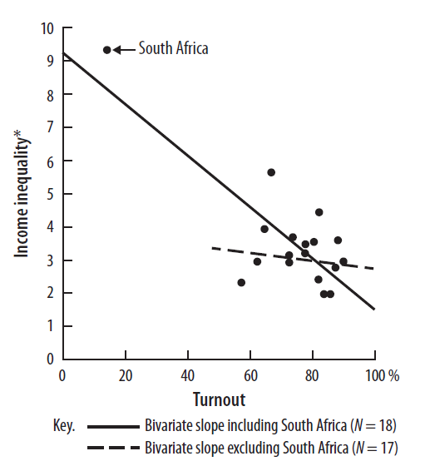
Detecting Outliers
An outlier is an observation that is “extreme”, being distant from the rest of the data
The association between voter turnout and income inequality based on a quantitative analysis of eighteen countries.

Slide 12
Detecting Outliers
Outliers can have disproportionate influence on models
An important step in data pre-processing is detecting outliers
Once detected, domain knowledge is required to determine if it is an error, or truly extreme.
In some contexts, finding outliers is the purpose of the DM exercise (airport security screening).
This is called “anomaly detection”.

Slide 13
Handling Missing Data
Most algorithms will not process records with missing values. Default is to drop those records.
Solution 1: Omission
If a small number of records have missing values, can omit them
If many records are missing values on a small set of variables, can drop those variables
If many records have missing values, omission is not practical
Solution 2: Imputation
Replace missing values with reasonable substitutes
Let you keep the record and use the rest of its (non-missing) information
Open “Ch2_0.R”
R Script.
Work with Table 2.7 Section

Slide 14
Normalizing (Standardizing) Data
Used in some techniques when variables with the largest scales would dominate and skew results
Puts all variables on the same scale
Normalizing function: Subtract mean and divide by standard deviation
Alternative function: scale to 0-1 by subtracting minimum and dividing by the range
Useful when the data contain dummies and numeric

Slide 15
Summary
Before algorithms can be applied, data must be pre-processed
Variable types, missing values, outliers, data normalizing & standardizing

Slide 16
Overfitting & Partitioning

Slide 17
The Problem of Overfitting
Statistical models can produce highly complex explanations of relationships between variables
The “fit” may be excellent
When used with new data, models of great complexity do not do so well.
Notes:
17

Slide 18
100% fit – not useful for new data
Notes:
18

Slide 19
Overfitting (cont.)
Causes:
Too many predictors
A model with too many parameters
Trying many different models
Consequence: Deployed model will not work as well as expected with completely new data.
Notes:
19

Slide 20
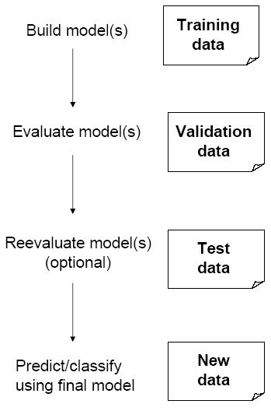
Partitioning the Data
Problem: How well will our model perform with new data?
Solution: Separate data into two parts
Training partition to develop the model
Validation partition to implement the model and evaluate its performance on “new” data
Addresses the issue of overfitting
Open “Ch2_0.R”
R Script.
Work with Table 2.9 Section

Slide 21
Building a Predictive Model
Multiple linear regression
In R, we use the lm() function to predict house value with the training data
then use the same model to predict values for the validation data
Open “Ch2_0.R”
R Script.
Work with Table 2.11 Section

Slide 22
Summary
To evaluate performance and to avoid overfitting, data partitioning is used
Data mining methods are usually applied to a sample from a large database, and then the best model is used to score the entire database

Slide 23
Next class
Data Exploration and Visualization

